Slide 1
Mbed: From a local connectivity to the cloud
Industrial Placement Presentation:
03/02/2012
Samuel Mokrani

Slide 2
Outline
Mbed
Internet of Things
WebSocket: new HTML5 feature
Connecting sensors to the cloud
USB Device Stack
USB Overview
Stack architecture
USB HID class
USB Audio

Slide 3
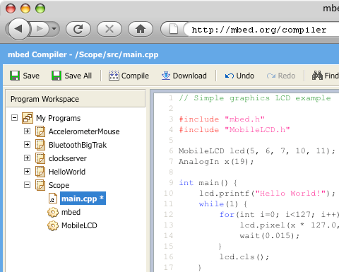
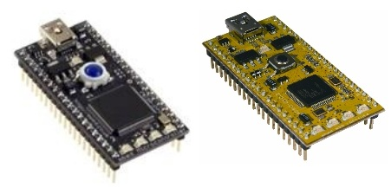

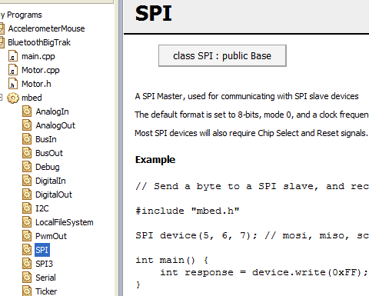
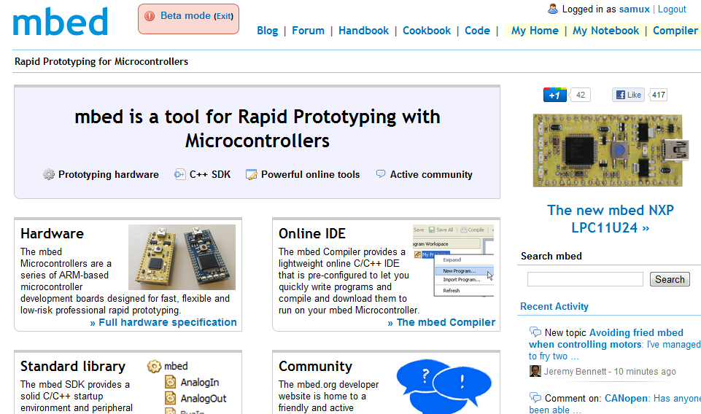
Mbed
What is Mbed ?
Cortex-M3 and Cortex-M0
boards
Online IDE
Rapid Prototyping
for Microcontrollers
C++ SDK
Active community

Slide 4
Internet Of Things

Slide 5
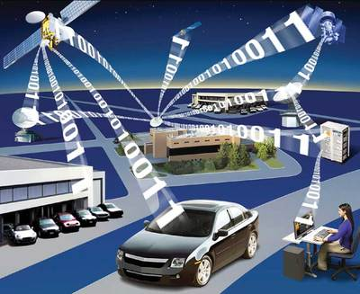
Internet of Things (IOT)
Physical objects addressable via the Internet
More and more devices connected to the Internet:
15 billion by 2015 according a prediction from Cisco
Connecting microcontrollers to the Internet is the first step of the IOT:
Smart buildings
Medical devices

Slide 6

IOT: WebSockets
New HTML5 feature (RFC 6455) providing:
Full-duplex communication
Over a single TCP socket
Standard and secure connections (ws:// and wss://)
Why a such new feature ?
Replace all existing polling techniques (AJAX)
Need a two-way communication without multiple HTTP connections
Overhead reduction
Less traffic
Less complexity

Slide 7
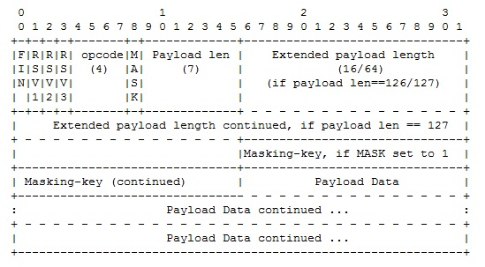
IOT: WebSockets
Handshake:
GET /ws HTTP/1.1
Host: example.org
Connection: Upgrade
Sec-WebSocket-Key: dGhlIHNhbXBsZSBub25jZQ==
Upgrade: WebSocket
Origin: http://example.org
Sec-WebSocket-Version: 13
HTTP/1.1 101 Switching Protocols
Upgrade: websocket
Connection: Upgrade
Sec-WebSocket-Accept: s3pPLMBiTxaQ9kYGzzhZRbK+xOo=
Response from the server
HTTP request from a client to upgrade
from HTTP to WebSocket
Data framing:

Slide 8
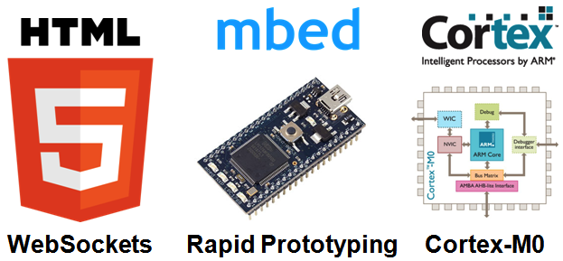
Connecting sensors to the cloud

Slide 9
IOT: connecting sensors to the cloud
Architecture:
WebSocket Server
(Python)
Mbed board +
Wifi module +
Sensor
(C++)
Mobile browser
(Javascript)
Desktop browser
(Javascript)
Browsers receive sensor data:
Mbed boards send sensor data to the server
The server broadcasts each received message

Slide 10

IOT: connecting sensors to the cloud
WebSocket server:
Based on Tornado webserver
ws://sockets.mbed.org/ws/<channel>/<mode>
A client is connected over a “channel”
Over a same channel, messages can be exchanged according the “connection mode”:
Write-Only (wo)
Read-Only (ro)
Read-Write (rw)

Slide 11
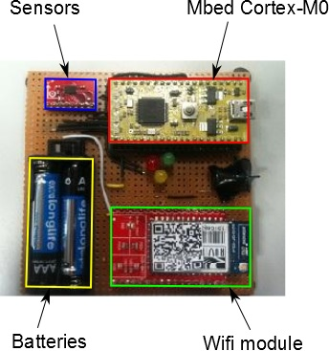
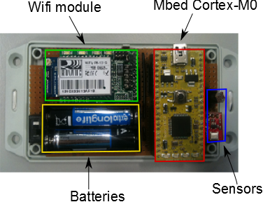
IOT: connecting sensors to the cloud
Mbed boards:
Connecting the boards to the Internet:
Wifi module from Roving Networks:
Full TCP/IP stack integrated
Communication over serial port with the Mbed
A WebSocket library on top of the TCP/IP stack
Connection to the WebSocket server

Slide 12
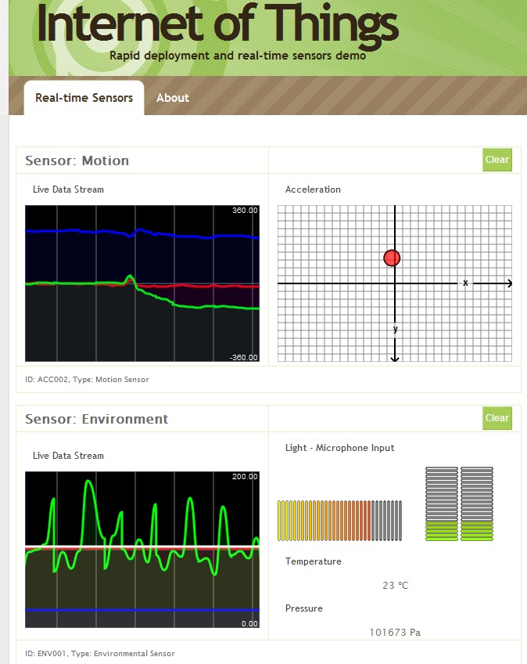
IOT: connecting sensors to the cloud
Browser architecture:
Open a WebSocket communication with the server
Listen WebSocket messages
Update real-time graphs

Slide 13

IOT: connecting sensors to the cloud
Dashboard

Slide 14
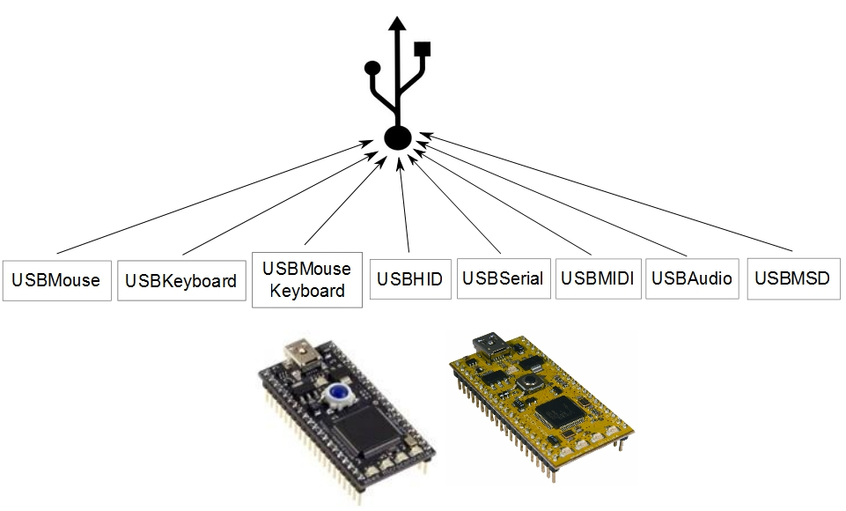
Universal Serial Bus: Device

Slide 15
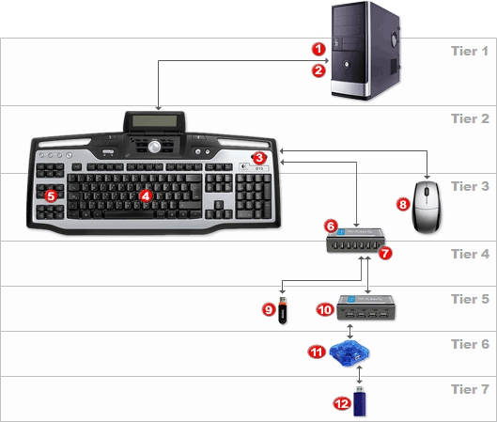
USB Device: Overview
USB 1.0 | Low Speed Full Speed | 1.5 Mbit/s 12 Mbit/s
USB 2.0 | High Speed | 480 Mbit/s
USB 3.0 | Super Speed | 5 Gbit/s
Topology:
One host
Several devices
Tiered star architecture

Slide 16
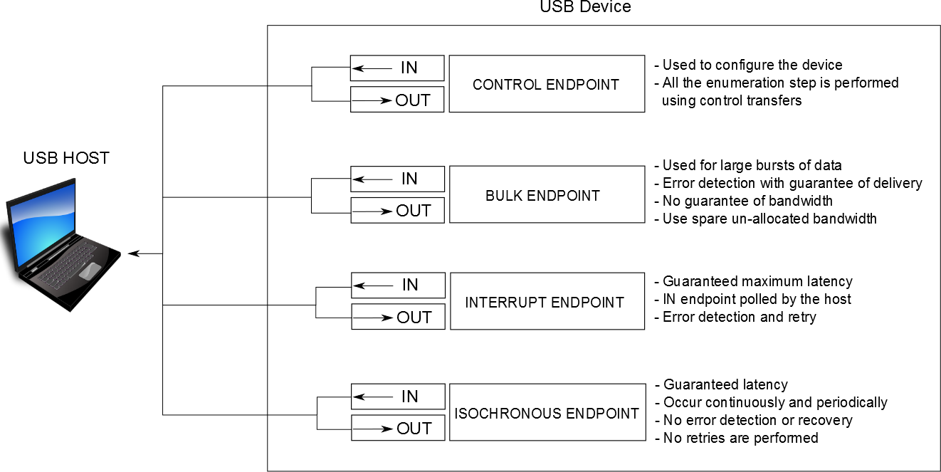
USB Device: Overview
Transfers:
Between “endpoints”
Different types according to different requirements

Slide 17
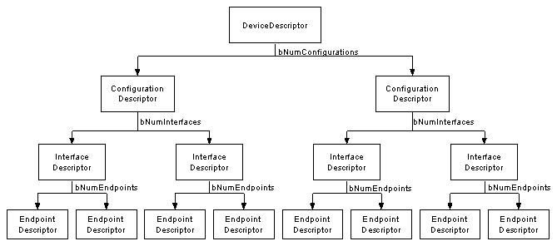
USB Device: Overview
Enumeration:
The host sets a unique address to the device
The host learns about the device capabilities to load an
appropriate driver
Device capabilities are contained in descriptors

Slide 18
USB Device: stack architecture
USBHAL
LPC11U24
LPC1768
USBDevice
USBHID
USBCDC
USBMidi
USBAudio
USBMSD
USBMouse
USBKeyboard
USBMouse
Keyboard
USBSerial
USBMSD_SD

Slide 19
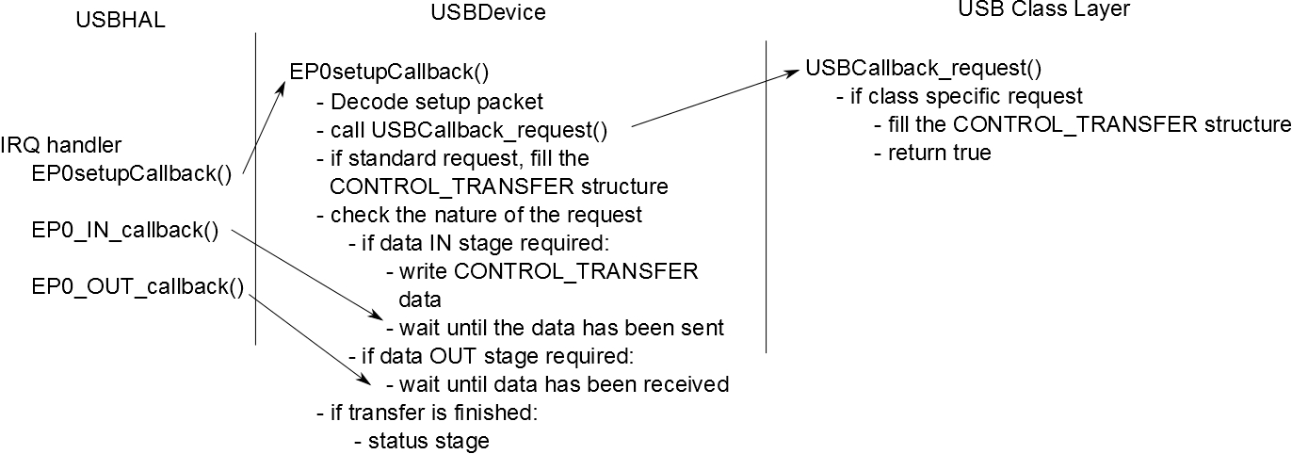
USB Device: USBDevice
USBDevice class:
No difference between the two targets
Enumeration step:

Slide 20
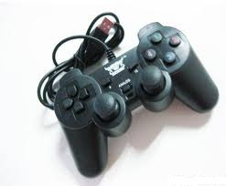
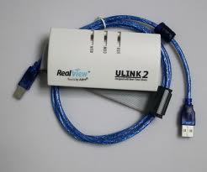
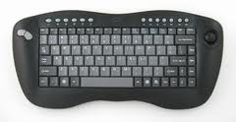
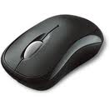
USB Device: USB HID
Human Interface device (HID):
Examples: mouse, keyboard, joystick
Can be a solution to exchange raw data with a computer
HID driver built-in in all operating systems
Class requirements:
Interrupt IN, OUT endpoints to send and receive data
Data are exchanged in data structure called “reports”
A report descriptor defines format and size of a report

Slide 21
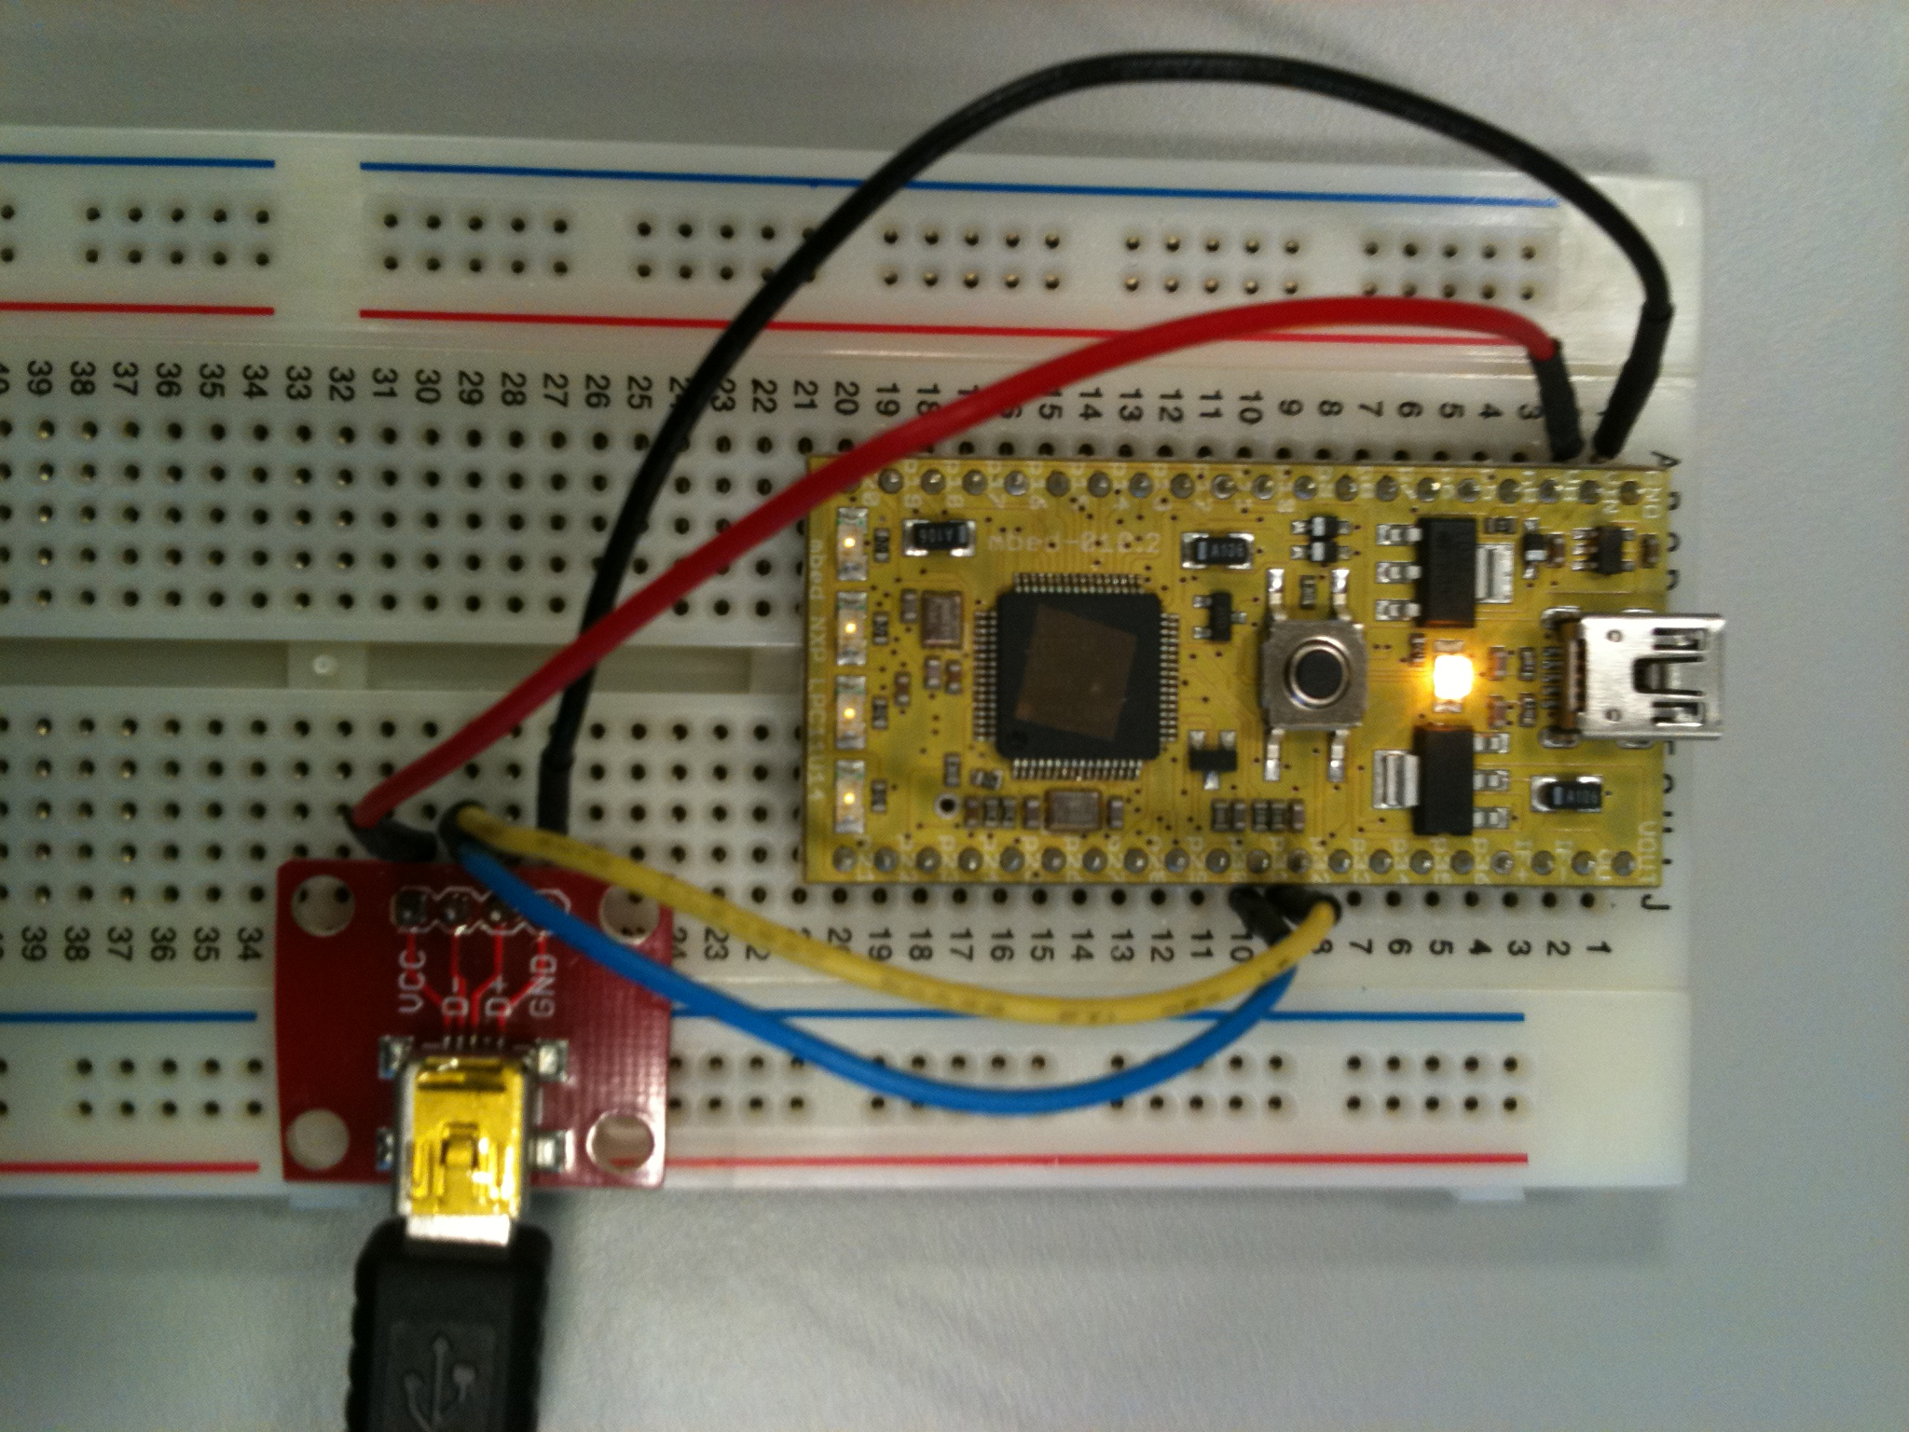
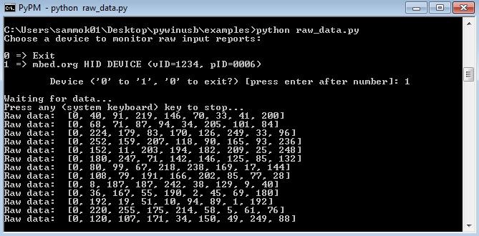
USB Device: Generic USB HID device
Report descriptor includes:
size of data: 8bits
Lengths of input and output packets

Slide 22
USB Device: generic USB HID device
#include "mbed.h"
#include "USBHID.h"
// We declare a USBHID device.
// Packets of 8 bytes can be echanged
// between the host and the mbed
USBHID hid(8, 8);
//This report will contain data to be sent
HID_REPORT send_report;
int main(void) {
send_report.length = 8;
while (1) {
//Fill the report
for (int i = 0; i < send_report.length; i++)
send_report.data[i] = rand() & 0xff;
//Send the report
hid.send(&send_report);
}
}

Slide 23
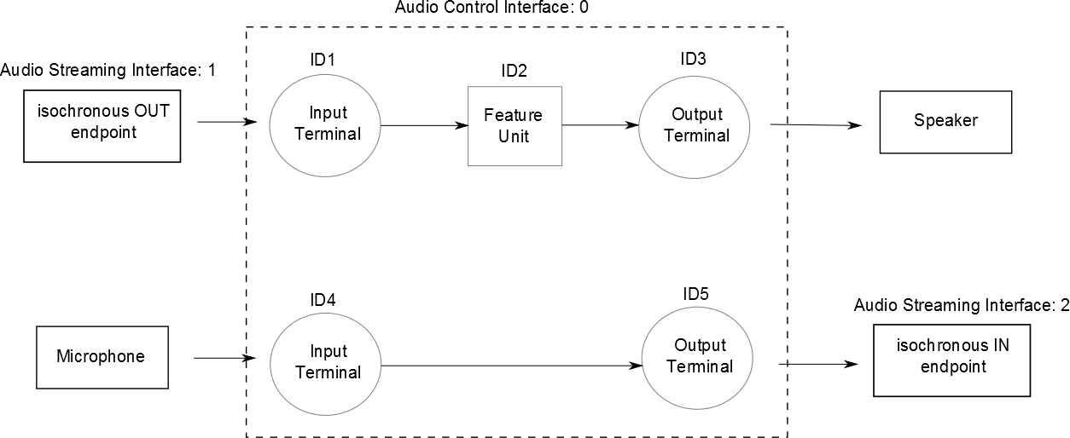
USB Device: USB Audio
Send and receive audio packets (PCM 16 bits signed) to or from a computer
Class requirements:
Isochronous endpoints

Slide 24
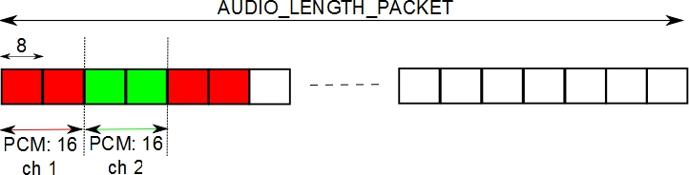
USB Device: USB Audio
Audio packets management:
On a Start of Frame event generated each millisecond
Packet length: according to frequency and number of channels
AUDIO LENGTH PACKET = (FREQ / 500) * nb channel

Slide 25
USB Device: USB Audio
// frequency: 48 kHz
#define FREQ_IN 48000
#define FREQ_OUT 48000
// 2 channels: stereo
#define NB_CHA_IN 2
#define NB_CHA_OUT 2
#define LENGTH_AUDIO_PACKET_IN (FREQ_IN / 500) * NB_CHA_IN
#define LENGTH_AUDIO_PACKET_OUT (FREQ_OUT / 500) * NB_CHA_OUT
USBAudio audio(FREQ_IN, NB_CHA_IN, FREQ_OUT, NB_CHA_OUT);
int main() {
int buf_stream_in[LENGTH_AUDIO_PACKET_IN / sizeof(int)];
int buf_stream_out[LENGTH_AUDIO_PACKET_OUT / sizeof(int)];
while (1) {
// read and write an audio packet
audio.readWrite((uint8_t *)buf_stream_in, (uint8_t *)buf_stream_out);
// fill the buffer for playback
for(int i = 0; i < LENGTH_AUDIO_PACKET_IN/sizeof(int); i++) {
buf_stream_out[i] = buf_stream_in[i];
}
}
}

Slide 26
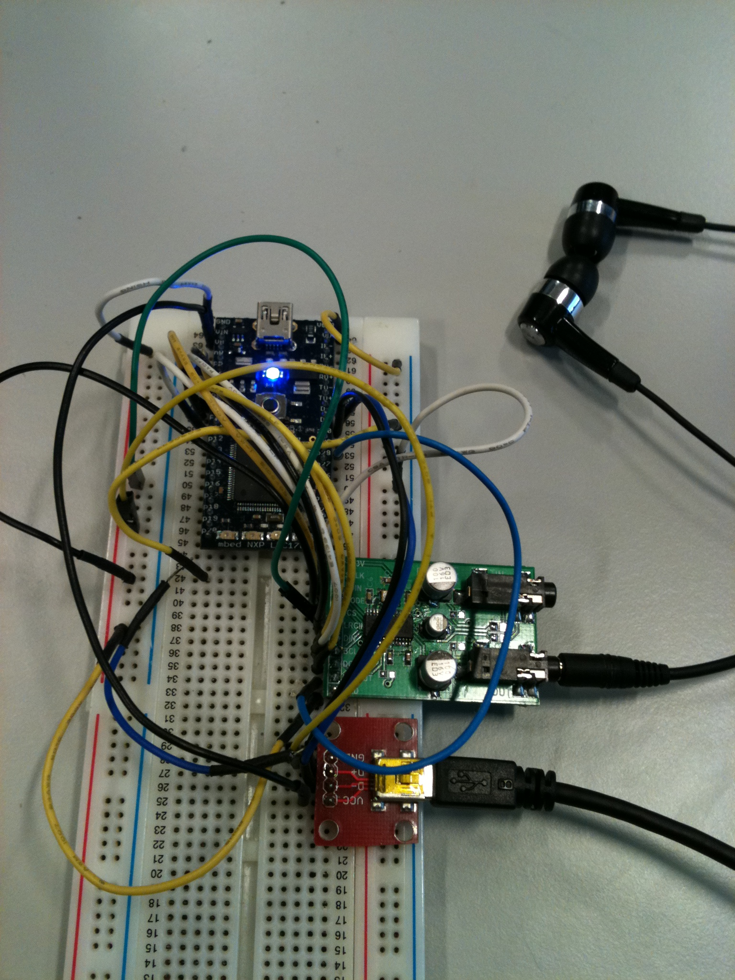
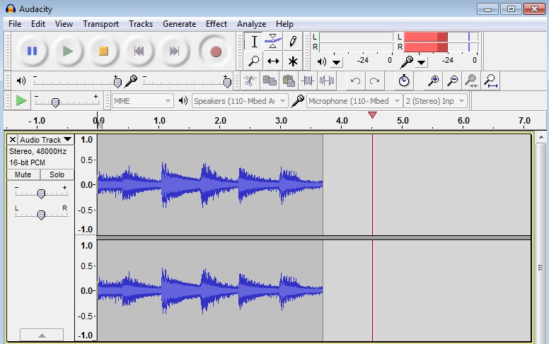
USB Device: USB Audio
USB Audio tests:
I2S/I2C DAC for the reception of audio packets
Software to capture incoming audio packets on the host

Slide 27
Conclusion
Internet Of Things:
Introduction of a new HTML5 feature on embedded systems
Connection of sensors to the cloud:
First prototypes
Basis for some potential IOT applications
Mbed as a USB device:
HID: generic HID, mouse, keyboard, PS3 controller
Virtual serial port
Mass Storage Device
Audio
MIDI

Slide 28
Thanks! Questions ?

